Slide 1
=
-Frances Moore Lappe

Slide 2
Why are we TOGETHER
creating a world that
we as INDIVIDUALS would never choose?

Slide 3
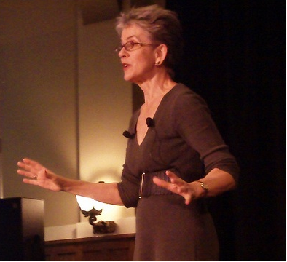
University of Iowa, 2011
Why together?

Slide 4
What’s WRONG
with the world?
?
Do you have a working theory about why our world is in crisis?

Slide 5
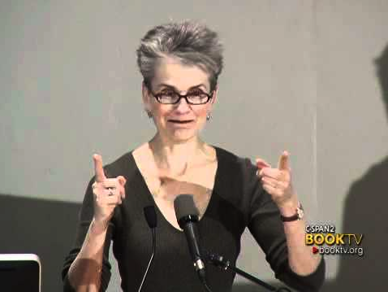
Mount Holyoke College, 2011
Why Hunger?

Slide 6
Have you ever had an experience
that caused you to realize
a new way of seeing things ?
?
Or an experience in
which you were
forced out of your old views or frames ?

Slide 7
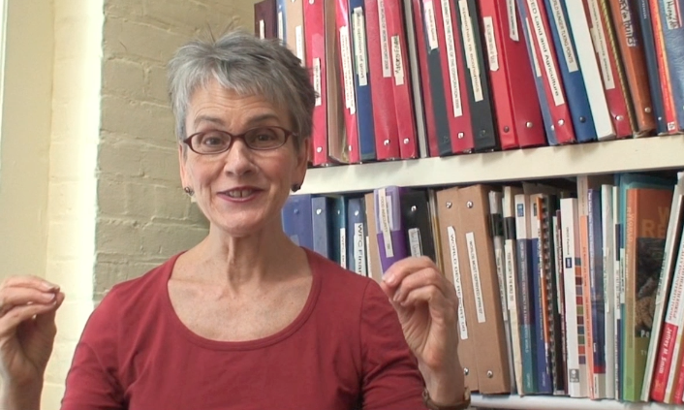
Small Planet Institute, 2014
3 Ss
7

Slide 8
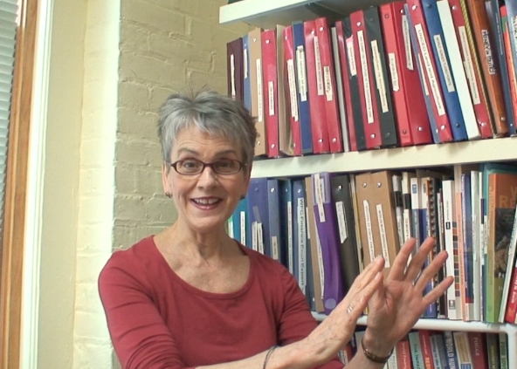
Small Planet Institute, 2014
3 Cs

Slide 9
Do you find that you relate
to any of these Cs and Ss personally?
Reflect on a time or event that was affected by at least one S and another time or event that was affected by at least one C.
?
What caused these feelings to appear?
What was their result?

Slide 10
Conditions & Capacities
?
What conditions stand out to you as being most problematic or beneficial in our society?
Which capacities are most present or meaningful in your life?
10

Slide 11
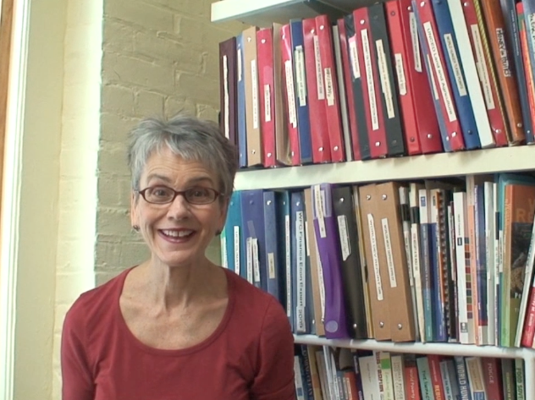
Small Planet Institute, 2014
Spirals of Powerlessness
11

Slide 12
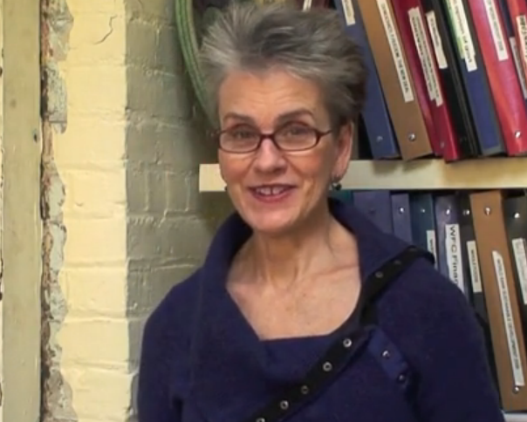
Small Planet Institute, 2011
Spiral of Empowerment

Slide 13
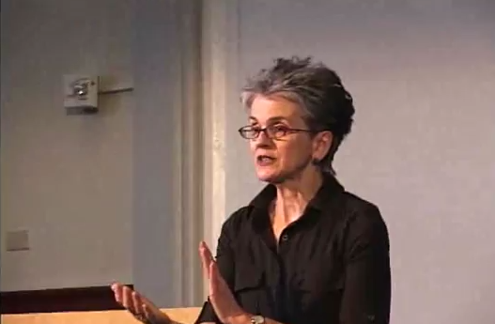
San Jose State University, 2011
Conclusion
13

Slide 14
WITH AN
ECOMIND…
It’s not possible to know what’s possible.
So we are free!
We are free to go for the world we want.

Slide 15
What was the most valuable part of the workshop for you?
What was the least engaging part
of the workshop?
What is one thing you would change to improve the experience of the workshop?
Were any sections too long or too short?
Was anything confusing to you?
Was there enough room for participation? Was there too much?
Anything else you’d like to share?

